Slide 1
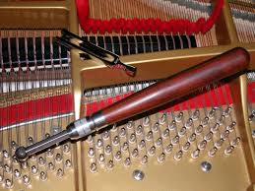
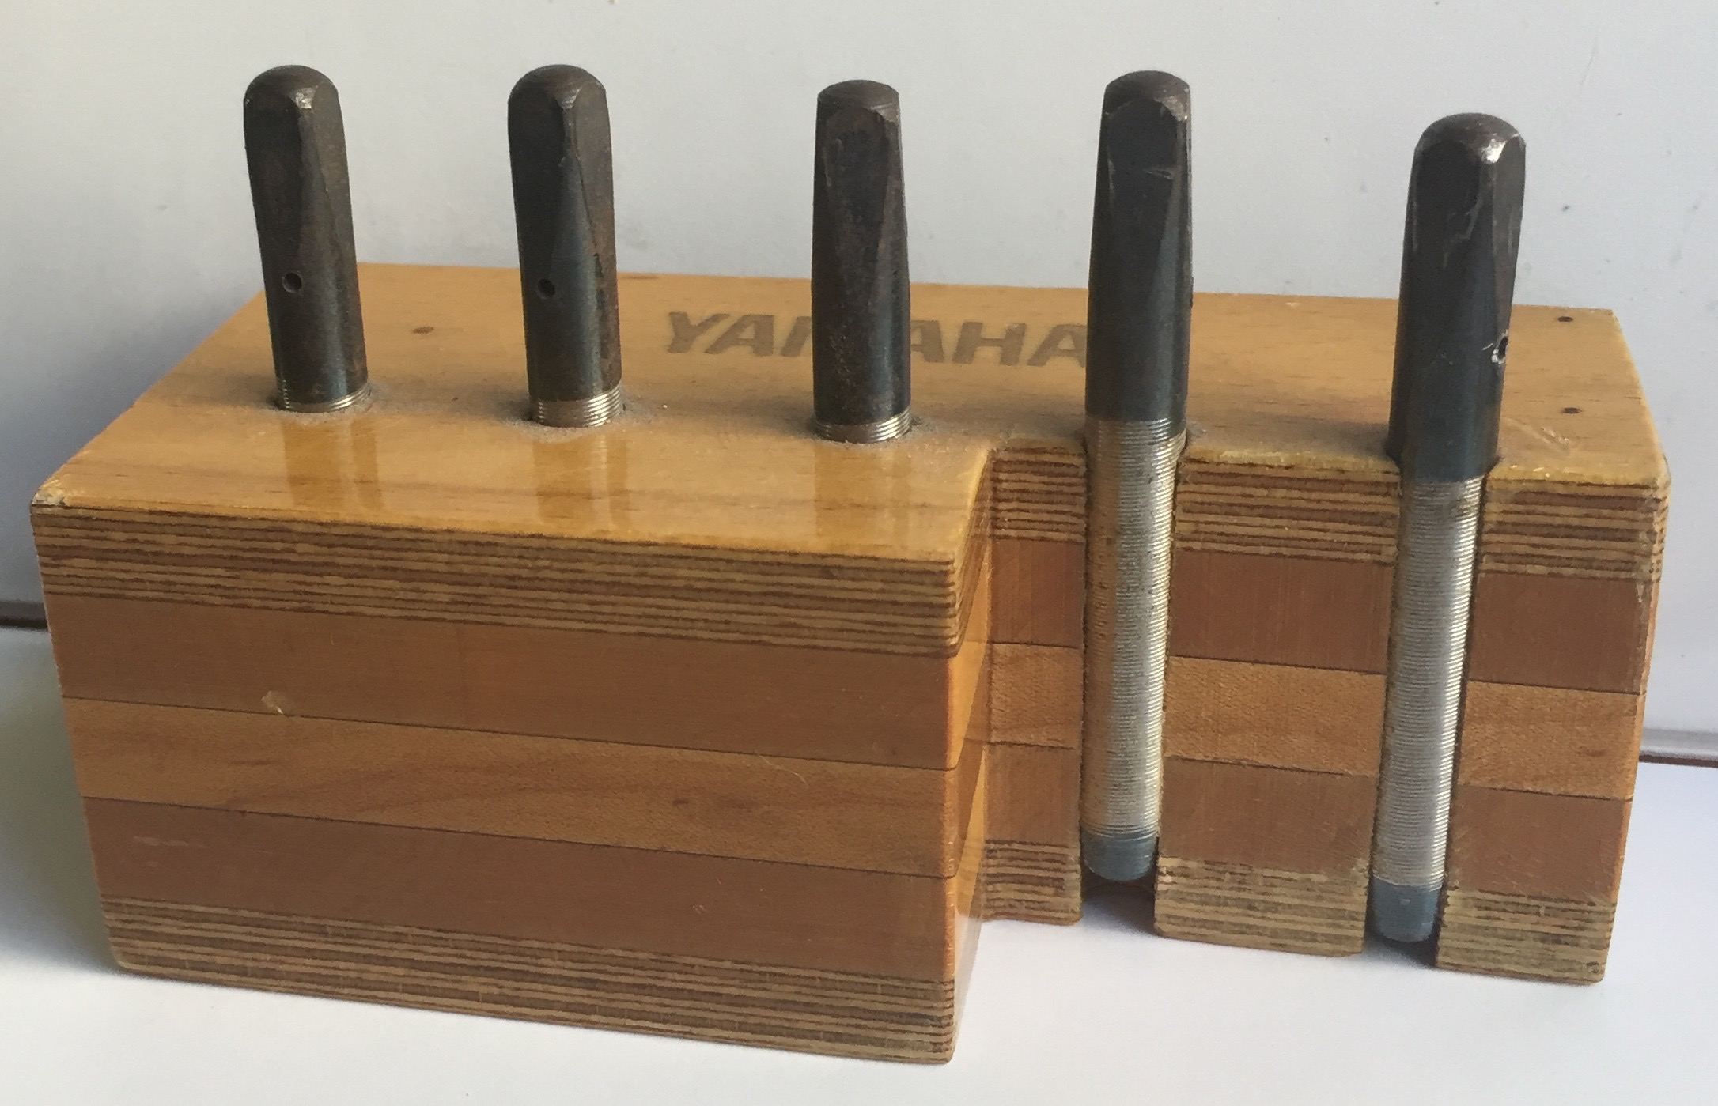
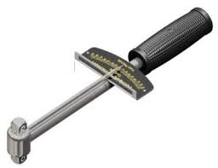
PIANO TUNING PIN Study
San Francisco Chapter
SYMPOSIUM at the GREEN MUSIC CENTER,
SONOMA STATE UNIVERSITY October 29, 2016

Slide 2
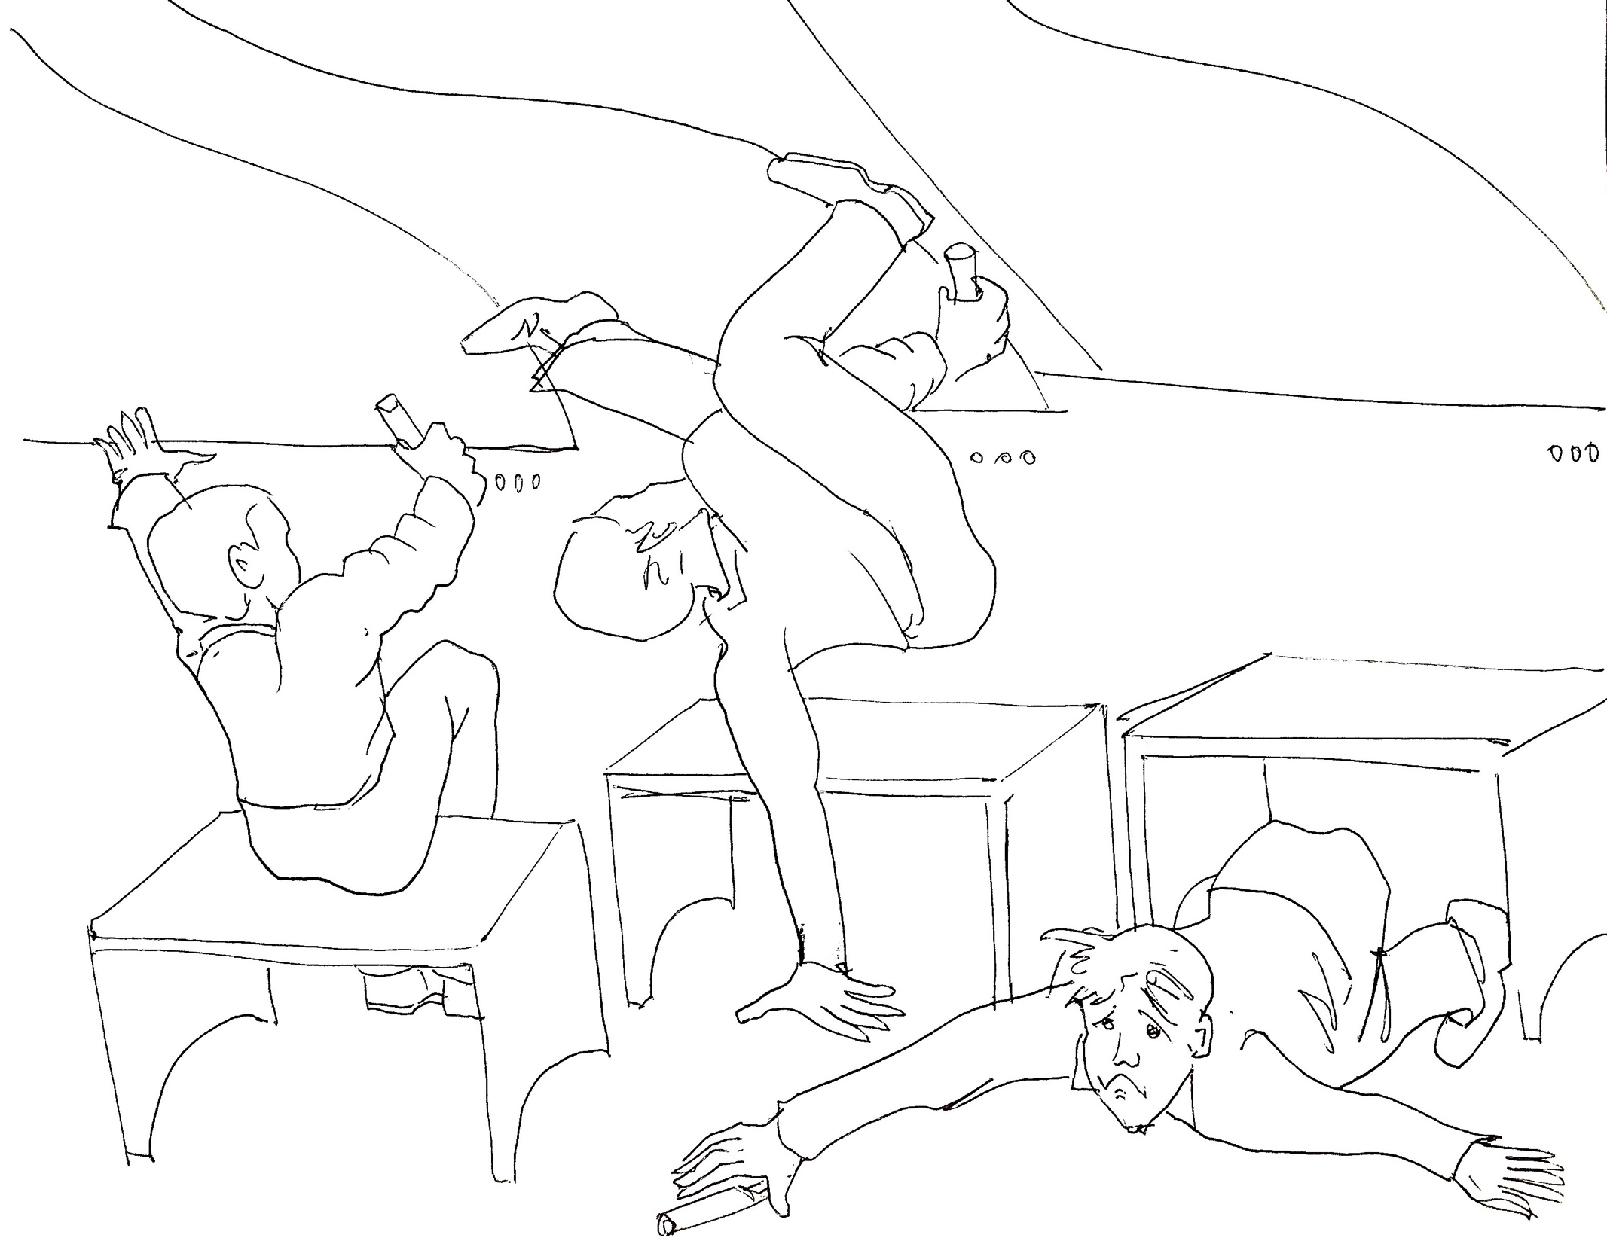
Purpose of Symposium
The primary hypothesis of our study is that tuning pin tightness (TPT) of new and rebuilt pianos has progressively increased in recent years, making it much harder to tune them, and resulting in LESS tuning stability.
Today we will gather data from pianos on campus to help support the hypothesis (or not). We’ll have future discussions, come to conclusions, then write a report on our findings for publication in the PTG Journal. Copies can be sent to piano manufacturers and rebuilders.

Slide 3
The elephant in the room…
It’s been my experience that piano tuners are reluctant to talk about hyper-tight tuning pins. Here are some reasons I think this is so:
They don’t want to admit they can’t tune certain pianos as well as they could, even though it’s not their fault.
They don’t want to admit they experience discomfort or pain when trying to tune pianos with hyper-tight pins.
They don’t want to get a reputation as a complainer, whether among other technicians, customers, piano store owners or manufacturers.
To illustrate the point, a certain technician I spoke to about this symposium said he agrees with the premise and is very interested in our results, but doesn’t want his name associated with it.

Slide 4
Did older pianos have less TPT?
In my experience as a piano technician for 45 years, I’ve long had the belief that pianos made in the distant past had less TPT. Some will say those pianos have been tuned so many times they’ve lost torque over time, but I don’t believe that’s true. An experiment that supports this will be shown later in this presentation.
The evidence I have is anecdotal and of a small sample, but I think it carries some weight. I owned two pianos for 25 and 15 years that I tuned frequently with no detectable loss of torque over time. I have customers whose pianos I’ve tuned many times over many years, with no noticeable change in TPT.
As technician here at Sonoma State for 5 years I’ve had a rare opportunity to see how pianos behave when tuned very often, under excellent climate control. Again, I’ve noticed no change in TPT on pianos I’ve tuned over and over. This is true both of pianos with reasonable TPT and those with supertight pins.
Technicians from previous generations have told me that older pianos were strung with very low TPT, as low as 45 in/lbs. I worked in rebuilding shops with many older pianos both European and American, and found this to be true. These pianos tuned beautifully and stayed in tune very well. I owned one for 25 years, and it held tuning better than any piano I’ve ever tuned.
Have you had similar experiences?

Slide 5
Whose problem is it?
Tuners can’t feel confident our tunings are as clean and stable as we could make them. Voicing is hard to do if you can’t get unisons perfectly clean. It’s frustrating not being able to do the best work we’re capable of. Our reputations can suffer through no fault of our own. Tuners’ health and ability to work are adversely affected.
Teachers, students, performers & audiences get pianos not as well-tuned as they could be. Whether they’re aware of it or not, pianos aren’t giving their full potential.
Dealers find it harder to sell instruments to discerning clients if tuning isn’t perfect. Tuners may get blamed though the fault isn’t theirs.
Manufacturer’s and rebuilder’s reputations suffer if tuners, dealers and customers are unhappy with instruments that can’t be tuned to the highest standard. Sales may not be as good as they could be.

Slide 6
What are we trying to do here?
From what follows in this presentation and the data we collect today, we hope to show that pianos made with excessively tight tuning pins are bad for piano buyers & owners, teachers & students, manufacturers, rebuilders & dealers, tuners & technicians, performance venues, performing artists, and the public. No one benefits; everyone is harmed by the practice.
The first intended result of this study is to bring this problem into the open so piano technicians are less reluctant to discuss it among themselves and with rebuilders & manufacturers. If we let them know how damaging this practice is to us and to them, maybe we can influence a change.
Further, we hope our data and discussions will show that pianos with high TPT can’t be fine-tuned as well, aren’t as stable, and don’t hold tunings well.
It’s hoped that the report of this symposium will be read by technicians, manufacturers and rebuilders world-wide and stimulate them to change, either by reforming their TPT standards or using the inventions designed to overcome the problem in their future products.

Slide 7
So it’s not just me…
“How easy or difficult it is to tune a piano depends on the behavior of the tuning pin in the pinblock.”
“A tuning pin that is too tight bends and twists so much above the pinblock that the pitch changes significantly before the pin turns in the pin block. In extreme cases you may not be able to tune the piano precisely.”
“Jumpy tuning pins can make fine tuning all but impossible.”
“The tighter the pin, the more the pitch changes during tuning.”
“Pianos Inside Out” by Mario Igrec.
“Multilaminated pinblocks …are more likely to have tuning pins too tight for careful tuning. A good pinblock must have a torque high enough to hold the strings in tune, but not so high as to prevent fine tuning.” “The Piano Book” by Larry Fine
“A tuner’s mastery of the subtle nuances of…tuning depends almost entirely on the finely developed capability…to accurately make minute and stable changes in…pitch.”
Daniel Levitan, “The Craft of Piano Tuning”
“As all piano technicians know, tuning pins can have various problems that interfere with accurate tuning.” Harold A. Conklin, Jr.
“Overtight pins make fine tuning a difficult task at best.”
Paul Larudee, inventor of the Lo-Torq tuning pin

Slide 8
The 3 most important things in tuning: Stability, stability, stability…
“The more you move the tuning pin, the more unstable the tuning.” –Norman Neblett, RPT
“..essential for tuning with stability includes skill in making tiny incremental movements of the pin in the pinblock.” - Michael Travis, RPT
“The more pitch is changed, the less it’s going to hold.” - Susan Graham, RPT
“Ultratight tuning pins make it difficult to impossible to do an accurate and stable tuning.” – Larry Lobel, RPT
Over-tight tuning pins work against fine tuning & stability. Tuners want to do their best for customers and help piano makers sell instruments, but TPT sabotages our efforts.

Slide 9
Some TPT history
For more than 200 years there have been many patented inventions designed to improve the piano’s tuning pin/string system. Various inventions re-designed either tuning pins or pinblocks.
Most of these addressed problems of pianos going out of tune, or tuning pins becoming loose over time. This is what manufacturers are afraid of, but they have mostly ignored the many ingenious solutions that have been devised, instead choosing to increase TPT, making it ever-harder to fine-tune their pianos.
Some inventions have been cockamamie ideas, others may have been good, but we never found out because they were never tried.
This one required 2 tuning pins for each string; obviously a costly addition to manufacture, and probably unworkable because of space limitations.

Slide 10
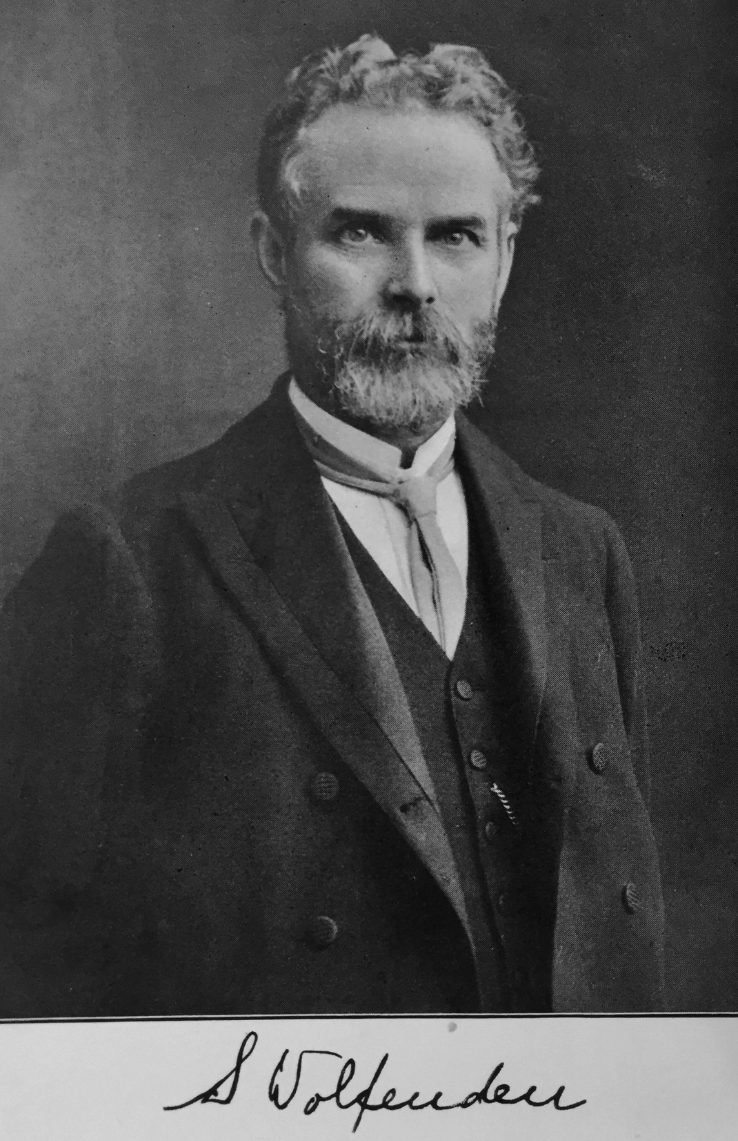
From a treatise of 100 years ago…
“For over a century efforts have been made to supersede the tuning pin driven into a wooden plank, and numerous inventions have been lodged with the Patent Office intended to make tuning more delicate and more stable. Plainly some of them must have been designed by men altogether without personal experience as tuners. Two main ideas run through all of them:
(1) to provide a bolt-and-nut action in place of the twisting action of the wrest pin, and (2) to set the wrest pin in metal instead of wood.
The first plan has proved in every instance a failure. Their expensiveness would prevent general acceptance, and tuners found them difficult to manage and less stable. The other has aimed at the exclusion of a wooden pin block entirely, fixing tuning pins in an iron plate. This required specially made & fitted pins whose cost has been prohibitive, and tuning pins in contact with iron become immovable by being rusted together.”
From “The Art of Pianoforte Construction” by Samuel Wolfenden, copyright 1916.

Slide 11
More bad ideas…
This one was designed to make the pin tighter to keep the string in tune; a misguided and expensive idea?

Slide 12
Lock the pins in place - seriously?
Another complicated, costly and probably foolish idea.

Slide 13
One that worked --
Mason & Hamlin adopted the 1888 “screw-stringer” invention, which eliminated the wooden pinblock that’s subject to climate variations. They used this on uprights and grands for quite a few years. Some of these are still around, and technicians report they are easy to tune, hold a tuning well, and don’t get loose over time. In spite of its success, the system was eventually abandoned because it was expensive to manufacture.

Slide 14
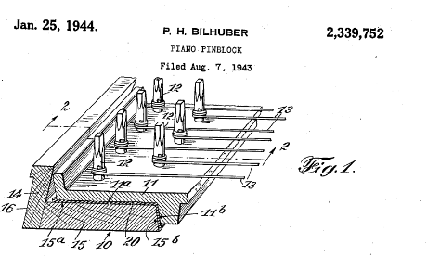
Steinway also tried --
Paul Bilhuber, longtime Steinway employee and designer, made an attempt at improving stability by redesigning both the pinblock and the method of fitting the pinblock to the plate. As far as we know, this system was never put in practice.

Slide 15
Another Steinway idea…
As recently as 1963 Frank Walsh at Steinway designed a pinblock that would “eliminate the stick-slip characteristic, while tuning pins would be held tight yet turn more smoothly and easily, for easy yet solid tuning, maintaining these qualities throughout long periods of use.” Don’t we wish that had succeeded?

Slide 16
Baldwin’s efforts ---
Baldwin designers addressed the issue several times over a period of years, with both pinblock and tuning pin re-designs. Carl Trinkle’s 1956 patent for a resin-bonded, multilaminated pinblock could have been the start of their infamous ultra-tight, snapping tuning pins. But his patent application contains valuable information relating to tuning pin tightness:
“The average piano tuner prefers a pin which has a torque in the range of 75 to 150 inch pounds.”
“A torque over the life of the instrument in the range of 50 to 100 inch pounds is regarded as ideal.”
“Pins having a torque of 35 inch pounds or less are regarded as “loose.” “
“The hole size compared with the diameter of the tuning pin was found to be a matter of very substantial importance.”
“Substantial stabilization of the tuning pin torque occurs after the conclusion of three wet-dry cycles.”
These statements give us some useful parameters for our study.

Slide 17
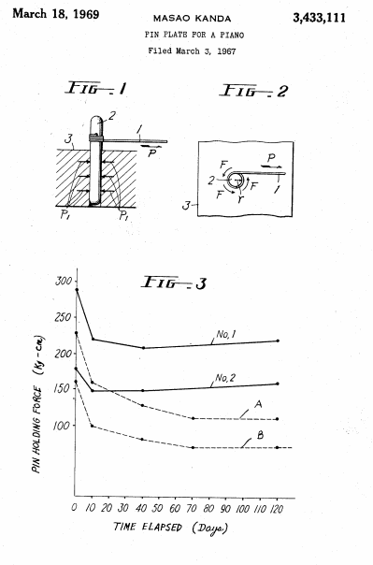
Kawai was on it too:
A US patent was granted in 1969 to Masao Kanda and assigned to Kawai for a synthetic pinblock. He gave torque values in kilograms/centimeter, which when converted to inch-pounds are comparable to Baldwin’s figures.
The scale of “pin holding force,” converted by multiplying by .87, goes from about 85 to 250 inch/pounds.

Slide 18
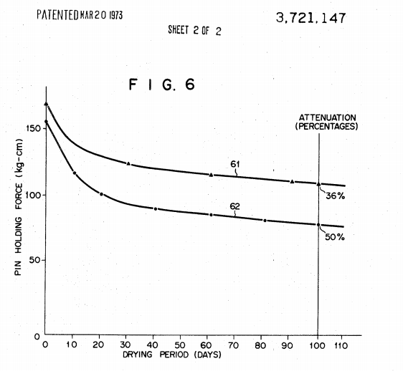
Kawai tries a different approach
A 1973 Kawai patent returned to a wood pinblock, with multiple layers bonded together with resin. The chart compares the pin holding force of the invention compared to conventional pinblocks over a period of 3-4 months. Torques converted to inch/pounds range from 150 to 100 for the patent pinblock, compared to 140 to 70 for the conventional block.

Slide 19
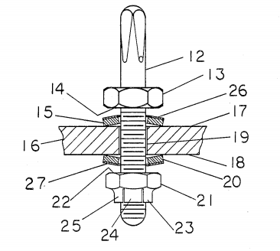
Another Baldwin effort
A 1990 patent granted to Baldwin’s longtime Director of Piano Research Harold A. Conklin, Jr. has a promising-looking redesign of ordinary tuning pins, with the addition of commonly available nuts & pressure washers, enabling never-before-possible control of tuning pin torque after holes are drilled and pins installed. It completely eliminates the wooden pinblock with all it’s climate & drilling problems; tuning pins are installed directly through the iron plate.

Slide 20
Much to learn from Conklin’s patent
Harold A. Conklin, Jr. was a brilliant piano engineer & designer with about 20 piano patents to his credit, many used in Baldwins. Some useful quotes from his tuning pin patent:
“The material and processing of the pinblock are crucial to tunability and longevity of a piano.”
“A precisely sized drill bit must be used, and close control of both rotational and axial bit speed is needed in order to produce cleanly-drilled holes of exactly optimum diameter.”
“Errors in drilling can cause the pins to be too loose or too tight and tunability to be poor. Installing the pins is also a critical operation.”
“Abnormally loose or tight pins can be caused by incorrect pin diameter. Pins are sometimes out of tolerance or out of round. Pins of irregular size produce non-uniform torque.”
Dirt, oil or other foreign matter in the pin holes can cause irregular torque or “stick-slip,” a ratchet-like motion of the pin that occurs if torque required to initiate pin motion is significantly higher than that needed to sustain the motion. Irregular torque or excessive stick-slip can prevent accurate tuning. Wide variations of torque from pin to pin frustrate good tuning results.” (ironic coming from Baldwin, notoriously guilty of that condition. – LL)
It seems most pianos manufactured today have some or all the above faults.
Harold A. Conklin, Jr.
1925-2009

Slide 21
Crucial statements in Conklin patent…
“Piano tuners generally prefer pin torque to be between 75-125 inch-lb. However, if a pin block is drilled to give torque values this low the pins may become too loose. Therefore, manufacturers normally make the initial torque higher than optimum for tuning.”
“In order to prevent loose pins, some manufacturers make the pins extremely tight when the piano is new. This practice can produce pin torques of 200-300 inch-lbs, and pianos that remain difficult to tune accurately for many years after they leave the factory.”
“My new type of tuning pin will make tuning easier, faster, and more accurate. I hope to convince piano manufacturers to use it!”
It’s too bad Conklin didn’t convince them, because it probably is a good design that would solve the problems with conventional pins. It wasn’t adopted by Baldwin, though they did incorporate many of Conklin’s other designs into their pianos. Why didn’t they try this one?
A few present-day manufacturers, like Fazioli, manage to get TPT in a reasonable range for fine tuning, the same on every pin, and they don’t get loose over time. How do they achieve this? Why aren’t other top-quality manufacturers doing it?
If you’ve ever had the pleasure of tuning a piano with the right amount of torque and consistent on all tuning pins, you must be as frustrated as I am that this is such a rare experience!

Slide 22
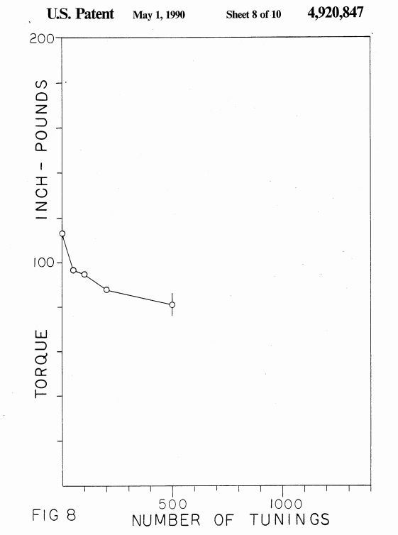
Are “loose pins” really a problem ?
Manufacturers fear that pianos leaving the factory with less than super-tight pins will lose torque over time from being normally tuned, and they’ll get blamed for pianos not staying in tune.
Chart from Conklin patent shows how torque drops with number of tunings. Starting with a newly-strung piano at 115 inch-pounds (much less than most modern pianos), torque drops to 95 after 50 tunings, 90 after 100 tunings, 85 after 200 tunings, and 80 after 500 tunings. The most drop occurs with the first 50 tunings; after that the effect tapers off sharply.
How often is a typical home piano tuned? Let’s say twice a year; at that rate it would take 50 years for torque to drop by 25 in/lbs, and it would still be 90, not loose by any standard. On a concert hall piano tuned 100 times a year torque would drop by 35 after 5 years, but again it would still be at 80, far from where pins are too loose.

Slide 23
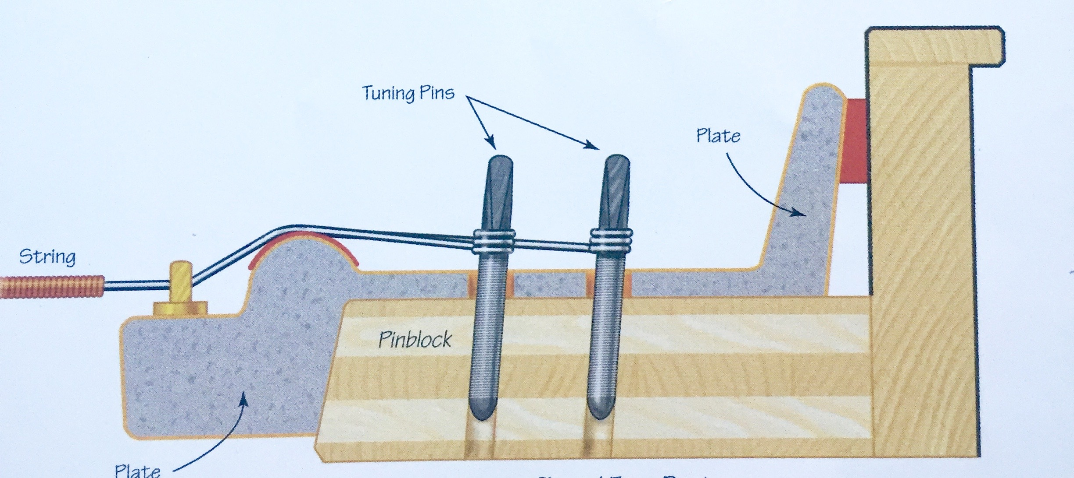
Can overtight pins be fixed?
It’s been suggested you can reduce torque on a tight pin by lowering string tension and working the pin back & forth. I’ve tried this several times and found it doesn’t work, or is only a temporary fix. In my experience, tight pins don’t “loosen up” over time or after several tunings. There is no fix, except to get it right when installing pins.
You can avoid causing tight pins when re-pinning by using Lo-Torq tuning pins, which come in half-sizes, among other advantages. Also by following proper drilling practices.
“…there is no satisfactory way to adjust the torque of a conventional tuning pin.”
- Harold A. Conklin, Jr.

Slide 24
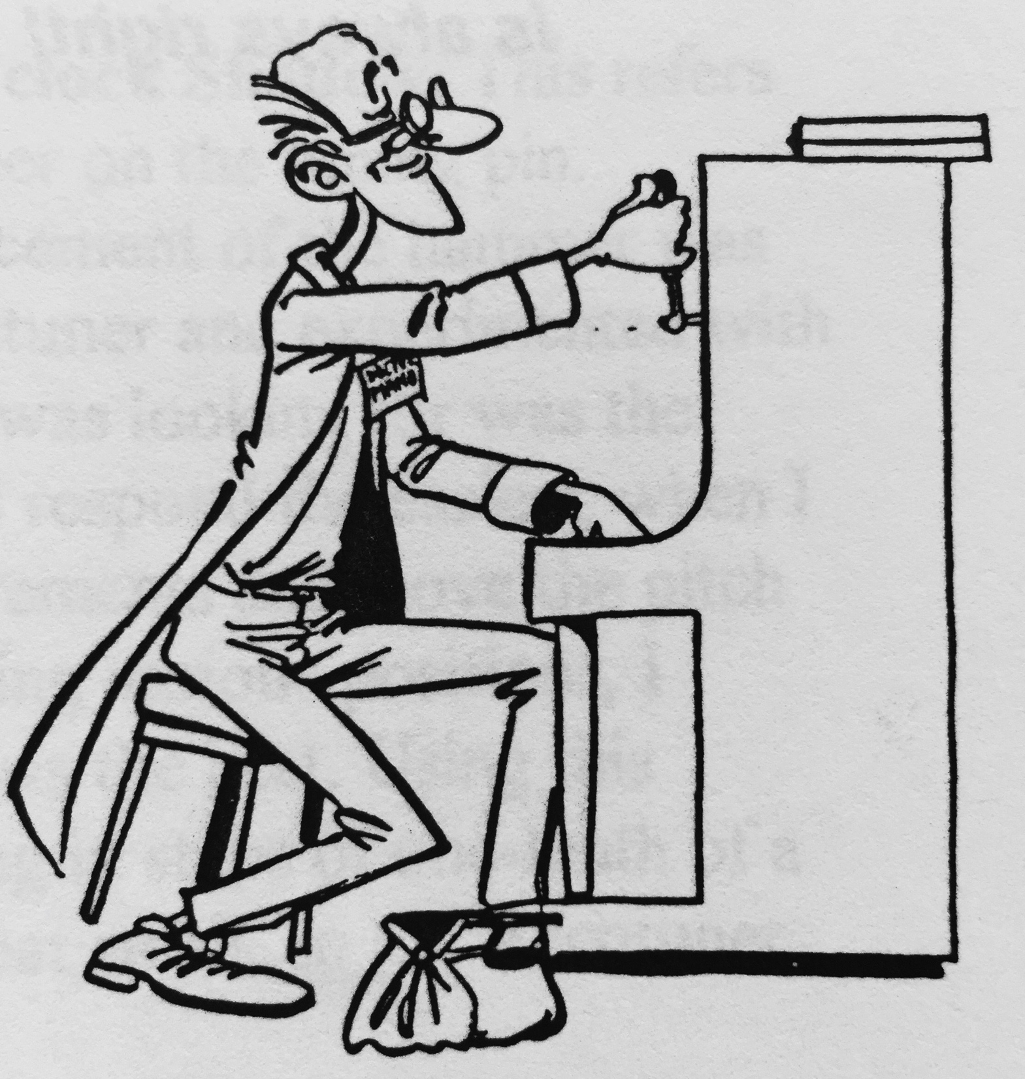
So how much torque should there be?
In several places in their patents Conklin and Trinkle give ideal TPT values, but they vary in the same document:
Conklin said TPT should be 110-115 inch/pounds, but also said 75-125 inch/lbs.
Trinkle said a good TPT is 75-150, elsewhere he said 50-100.
Mario Igrec’s comprehensive book gives a range of 125-150
Obviously, the best TPT covers a wide range. If we average the above numbers it works out to 85-125, plus or minus 25. This seems like a reasonable method to determine a standard applicable to all pianos.

Slide 25
Our task for today
We have 29 grand & upright pianos to measure, made between 1899 and 2014. Most have original pin blocks, tuning pins & strings; only a couple have new pin blocks. Some have new bass strings with original pins & block.
The brands are Baldwin, Chickering, Fazioli, Kawai, Steinway & Yamaha. Most have been at Sonoma State since new. Older ones were acquired used but have been here many years. All are tuned regularly and frequently; practice & studio pianos 5-10 times a year; concert pianos 20-50 times per year.
Each person who brought a torque wrench will be leader of a group. Those who don’t have torque wrenches, choose the group/leader you want to work with:
David Abdalian, Douglas Braak, David Gordon, Alberto Lana, Larry Lobel, Vladan Temer.
It’s OK to have more than one wrench per group; measuring will go faster. Everyone in the group should perform the measurement, to verify consistent results.
For each piano, measure torque on one pin of A2, A3 and A4. Results should be within 5-10 in/lbs of each other; if not the leader should determine which measurement seems most accurate. It doesn’t matter which string you use; if a pin is hard to measure use another one in that unison. If no pins of a unison are usable, choose another note close to it. Measure and record down torque (lowering pitch) first, then up torque (raising pitch). If your wrench is calibrated in other than inch-pounds, you can use the conversion tables provided, or just record the numbers you get, but note on your data sheet what calibration method is on your wrench.
After you finish measuring each piano, please re-tune the strings you de-tuned and any adjacent strings that are out of tune.

Slide 26
Conklin on measuring TPT
Free torque (a pin with no string) will be the same for clockwise and counterclockwise rotation.
A suitable value for free torque is about 105 inch-pounds.
When a string under tension is on the pin, up and down torque will change but the average doesn’t change.
The string will produce a torque of about 30 in-lb. Therefore, up torque will increase from 105 to 135, and down torque will decrease from 105 to 75. (but overall torque remains 105)
These values are within the range considered by piano tuners to be optimum. A suitable value for pin torque will be about 100 to 115 inch-pounds.
* * * * * * * * * * *
Some technicians (and piano factories) measure up torque only, or down torque only. Neither measurement alone gives an accurate picture of TPT; it must be an average of up and down:
U+D/2=TPT (Up Torque plus Down Torque divided by 2 equals Tuning Pin Torque)

Slide 27
Torque measuring technique
Place torque wrench on tuning pin
To avoid breaking strings, first measure down torque (lowering pitch) by moving wrench counterclockwise. Person who measures, or another group member, should play note repeatedly while measuring to monitor pitch change.
Move wrench slowly with steady, gentle pressure. Watch needle move and feel for tuning pin movement in pinblock. You need to feel the tuning pin move in the pinblock; this may not happen until after the pitch starts changing.
When tuning pin starts to move, indicator needle will stop moving; keep light pressure on handle until you get a reading. If you’re not sure the reading is accurate, repeat.
On the same tuning pin measure up torque (raising pitch) by moving wrench clockwise and follow same procedure as above. Don’t raise pitch higher than where you started, to avoid breaking strings -- play the note while you measure, so you can hear pitch change and avoid going dangerously sharp.
Please have someone in group re-tune all notes you measure back to clean unisons.

Slide 28
How to fill out data form
Each group will measure 5 pianos.
Read instructions for help; any questions call or text Larry at (707) 762-5800 hayforker@comcast.net
Please list names of all technicians in your group.

Slide 29
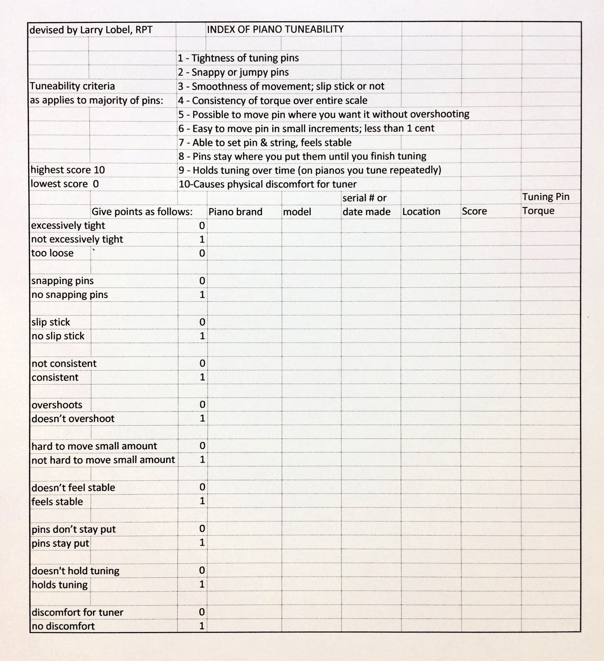
Another way to measure TPT…
I developed a “Tuneability Index” as quick way to rate how hard it is to tune a piano, with no torque wrench needed. It’s admittedly subjective and imprecise, but when combined with torque measurements could be helpful in correlating TPT with tuneability.

Slide 30
Map to the pianos ---
You will get a copy of this map in your information packet. Thanks for participating, and have fun!

